Slide 1
Introduction to DocumentDB
Brian Korzynski

Slide 2





































Platinum Sponsors
Gold Sponsors
Silver Sponsors

Slide 3
About Me
Owner of Korzynski LLC
Independent Consultant for 3+ years
http://www.korzynski.com
Professional Developer for 7+ years
Windows Forms
Web
Mobile
SQL Optimization
Data Analysis
Mathematics
Big Data
Cloud

Slide 4
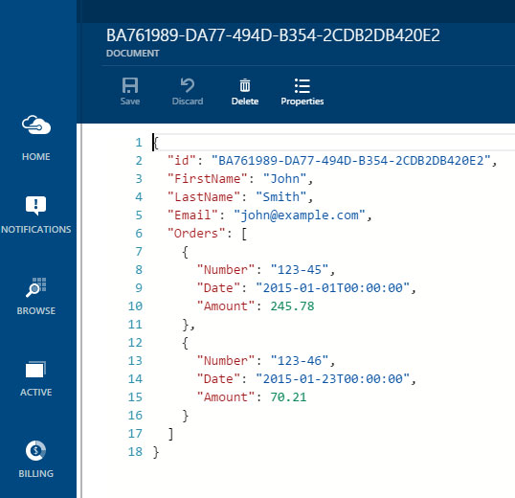
Document Database / No-SQL
Key/Value store
Allows data to be semi-structured or unstructuted
Allows you to modify schema without having to touch every “row” (document) (eventual consistency)
You Typically serialize to and store as JSON

Slide 5
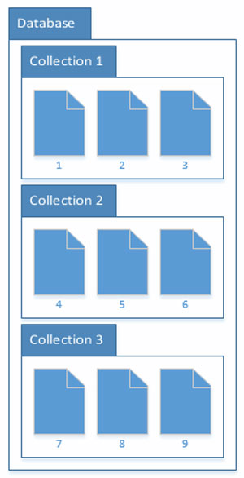
What is DocumentDB?
No-SQL Document database in Azure
Database = Container of Collections
Collection = groupings of documents
Documents = JSON serialized data records
I tent to think of collections as tables and documents as rows in the traditional database sense
Still a new service so it can only be access thru the preview portal

Slide 6
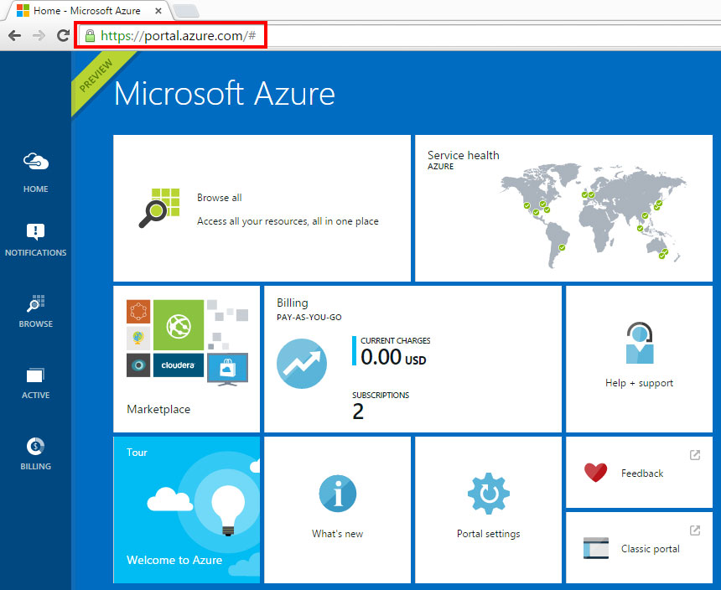

Slide 7
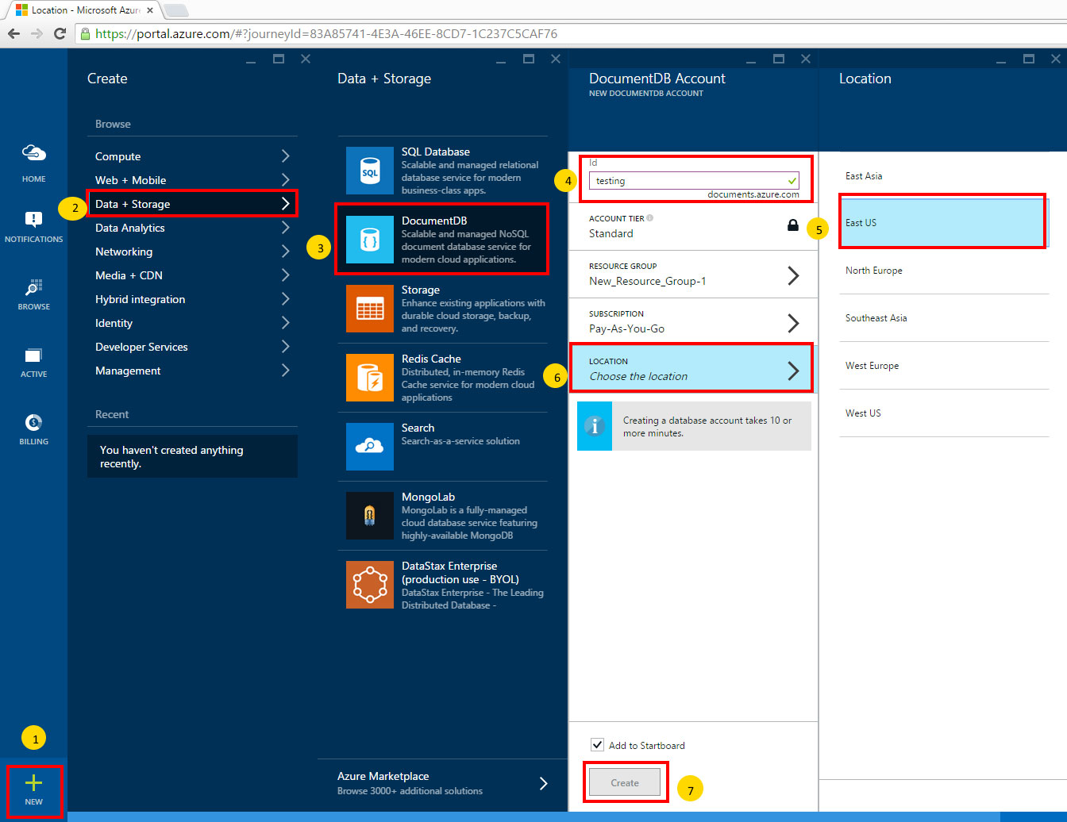

Slide 8
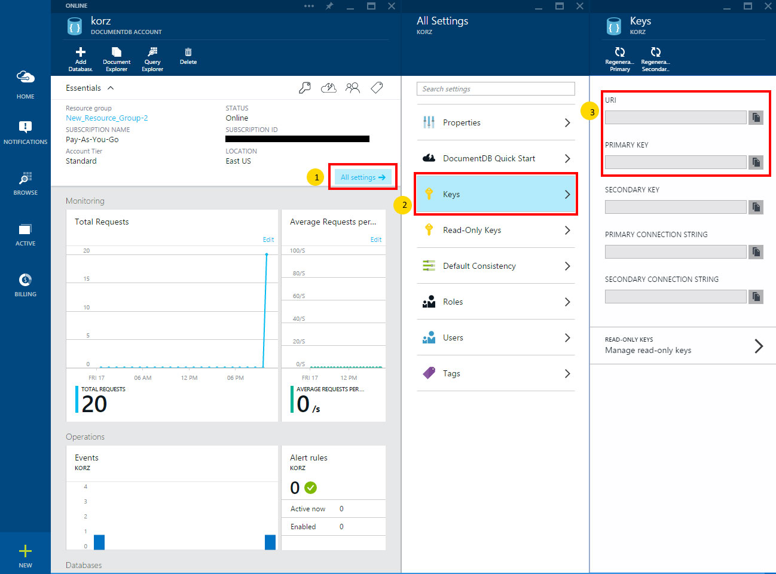

Slide 9
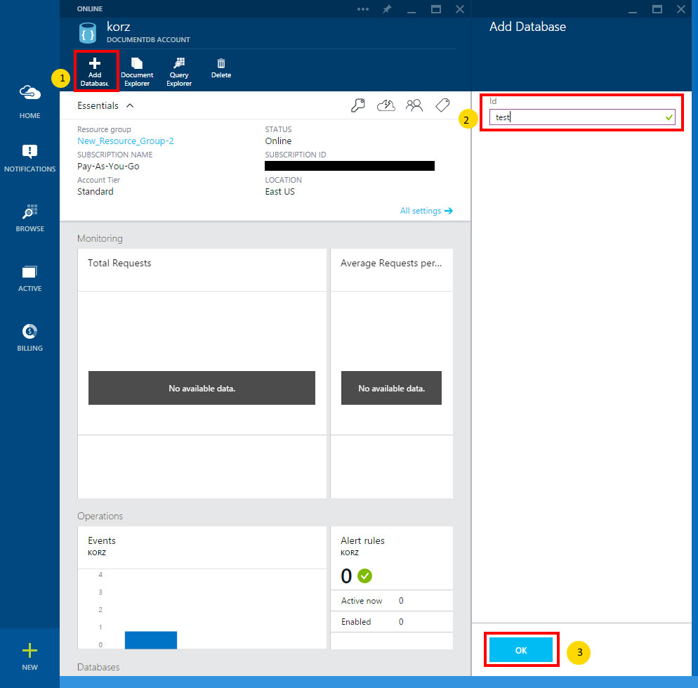

Slide 10
Regions
Physical locations of the Azure data centers
Today I will be using East US data center
East Asia
East US
North Europe
Southeast Asia
West Europe
West US

Slide 11
Mongo vs. DocumentDB
MongoDB
Has been around longer
More features
Allows plugins
On premises or in cloud
DocumentDB
Fairly new
Not a lot of features
No plugins
Cloud only
PaaS (always up to data)
Very little configuration
There are a lot of things you don’t have to be concerned with (2 slides from now)
Benefits of the cloud (next slide)

Slide 12
Benefits of the Cloud
Secure
Durable
Highly-Scalable
Highly-Available
Pay only for what you use
Build in redundancy (Azure always maintains at least 3 copies of your data)
Plays nice with other cloud services

Slide 13
Advanced Topics
Indexing
Is done at the collection level and works just like other document databases
Sharding
This is enforced by collections and collection size limitations (currently 10GB per collection)
Replication
Not really a need for replication since it is the cloud
Backups
Microsoft ensures this and also maintains 3 copies of your data at all times
Plugins
There aren’t any that I am aware of as of today

Slide 14
Advanced Topics – Cont’d
Map/Reduce
Most people that are used to document databases are used to Map/Reduce queries
This is supported in DocumentDB by writing JavaScript code
We won’t have time to get into this today

Slide 15
Limitations
Document
512KB
DocumentDB account
500GB
100,000 Request Units
5 DocumentDB Accounts
100 databases per account
500,000 users
https://azure.microsoft.com/en-us/documentation/articles/documentdb-limits/

Slide 16
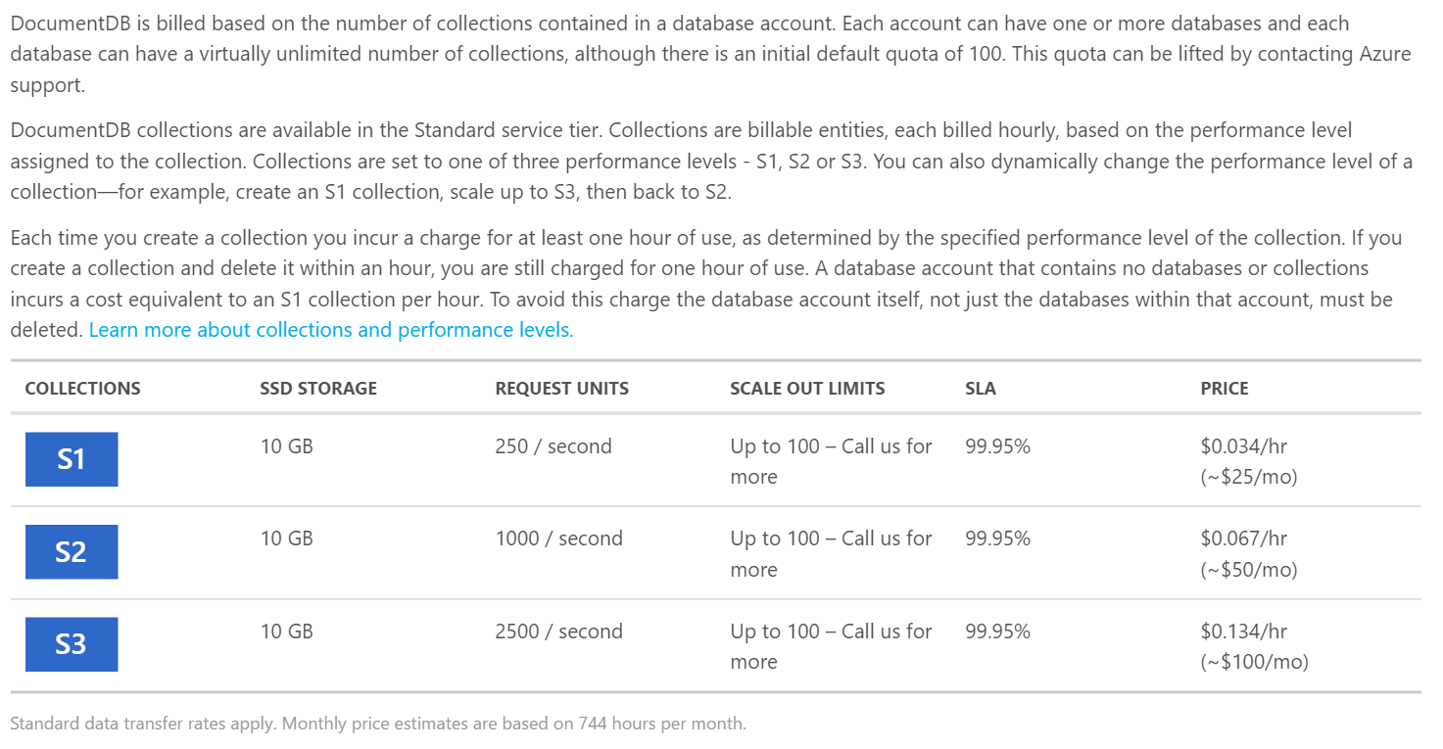
Pricing

Slide 17
DEMO

Slide 18
Pro Tips
Document databases /NoSQL have their place, but so do RDBMS (relational databases), so don’t try to use one to replace the other
Experiment with DocumentDB especially if you aren’t familiar with document databases, as it will add another tool to your arsenal
When selecting a region, choose one that is close to you and/or your other Azure services to cut down on latency
Very your project fits within the limitations
Make sure you are partitioning your data correctly, as it could cause a lot of pain
https://azure.microsoft.com/en-us/documentation/articles/documentdb-sharding/

Slide 19
Questions
http://www.github.com/korz
@bkorzynski

